Slide 1
Applying for Graduate Awards & Funding
Dr. Melanie Janzen
Associate Dean – Graduate Programs and Research
August 2023

Slide 2
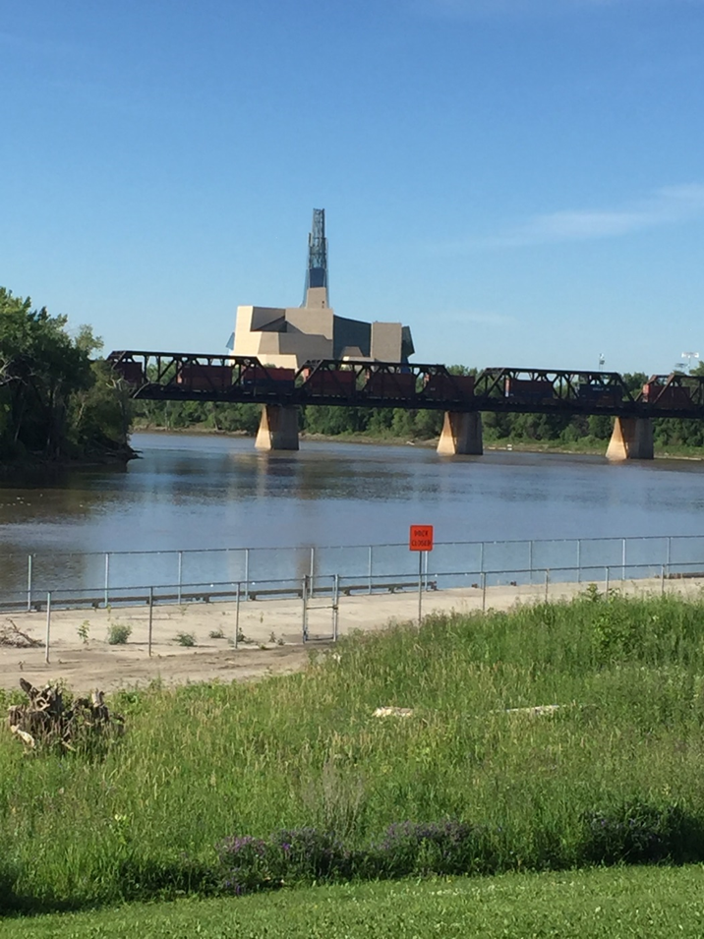
Traditional Territories Acknowledgment
The University of Manitoba campuses are located on original lands of Anishinaabeg, Cree, Ojibwe-Cree, Dakota and Dene peoples, and on the homeland of the Red River Métis.
We respect the Treaties that were made on these territories, we acknowledge the harms and mistakes of the past, and we dedicate ourselves to move forward in partnership with Indigenous communities in a spirit of Reconciliation and collaboration.

Slide 3
AGENDA
Welcome & Introductions
Why Apply for Graduate Awards
Where and How to Apply
Tips for Compelling Applications

Slide 4

Why Apply for Awards?
Funding $$
To receive peer-review evidence of merit
To build CV
To demonstrate research capability
= having awards can lead to more awards!

Slide 5
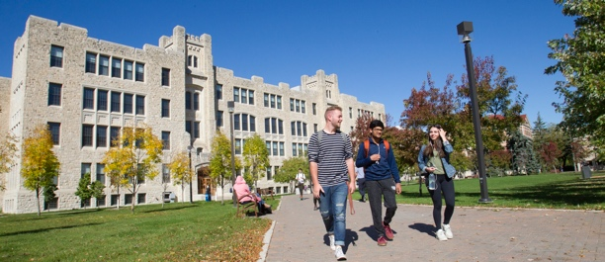

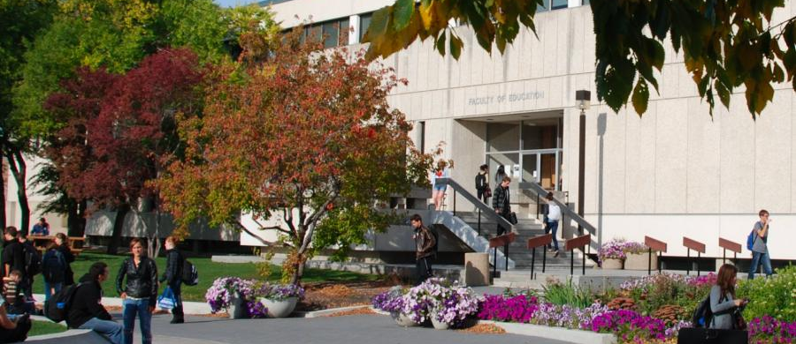
Where to Find Graduate Awards
External
UManitoba
Faculty
SSHRC (Doctoral & Vanier)
Pierre Elliott Trudeau Foundation (Doctoral)
CSSE groups, etc.
UMGF ($14k & $18k)
FGS Database
UM GSA Awards
Awards & Scholarships
Faculty Research, Conference and Manuscript Prep Funds
Other

Slide 6

Seeking Awards
Review all website info (esp FGS & Faculty of Education)
Read the newsletters and announcements
Attend FGS workshops
Be prepared to apply:
  Keep your CV up-to-date
  Give your references time to write your letters
Apply, Apply, Apply!!

Slide 7
Applying for Awards
Read criteria carefully.
Write the cover letter (or statement) to clearly demonstrate how you meet the criteria. Do not use the same letter for different awards.
Have a clear statement of research prepared and tailor it to the award. How does your experience, identity/ies, research interests, etc. meet the criteria of the award?
Ask your references well in advance of the deadline. For large grants (e.g. SSHRC or Vanier) they may work with the ADGR for support.
Familiarize yourself with the portal and application process well in advance of the deadline. Don’t leave it to the last minute.
Note upcoming awards & their deadlines in your calendar. Keep your advisor informed.

Slide 8
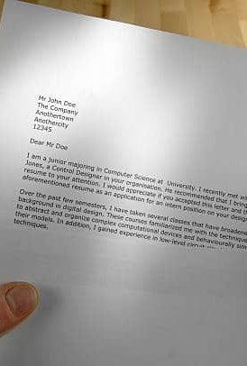
Cover Letter
Use a professional letter format (date, your name, contact info, etc; receiver’s information, RE: Teacher Researcher Award)
Use the correct name of the organization and person reviewing the award & use their appropriate titles (e.g. Dear Dr. Janzen)
Speak specifically to the criteria of the award and provide evidence of how you meet these criteria
Use bold text to highlight key elements
Note the word length criteria

Slide 9
CV
Keep your CV up-to-date
Highlight:
  Education
  Professional Experience
  Research (grants, publications, conferences, etc)
  Teaching (courses)
  Service (committee service to the University and faculty; community service)
  Are there things that the award is focused on that should be highlighted/added?
*Consider using the faculty template

Slide 10
References
Your Program Advisor is your most important reference
Be professional when making your request
Ask well in advance of the deadline; more substantive applications require more substantive reference letters (e.g., Vanier, SSHRC). Keep your advisor abreast of your application plans.
Confirm their agreement before you include their name on applications
When you ask include:
  your CV;
  the criteria of the award;
  your research statement or other materials that you are required to submit;
  if stated, the information required by the funder for the reference letter (evaluation criteria, word length, formatting);
  the deadline for the reference letter; and
  the process/place for submitting
*Make it as easy as possible for your reference to review the materials you provide

Slide 11
Faculty-Funded Awards
Graduate Research Award
Graduate Conference Award
Graduate Manuscript Preparation Award
These are all on a rolling basis--apply when you need it!

Slide 12
Questions or Comments

Slide 13
